Slide 1
Title: E-Commerce Data Analysis -
Data Analyst Intern Task
Your Name: Sanskriti Rai

Slide 2
Objectives & Approach
Objective : The task is to clean the data, analyze it, extract useful insights and then present your findings in a short report with visualizations. Dataset link: eCommerce behavior data from multi category store
Approach :
The dataset given for the task was extremely huge with more than 42 Million rows, hence the computation was resource-intensive.
I used a parallel processing python library which has similar syntax to Pandas, named Dask. It is extremely efficient and fast. Dask works on the philosophy of lazy evaluation and does not do in-depth calculation unless called out to.
Data Cleaning was handled using Dask then saved the file into a parquet format. Parquet stores files into binary format thus saving space and allows faster computation.
Using this method of Dask + Parquet, I successfully reduced 5.3 GB of dataset into 2.1 GB. Furthermore, data analysis was done using Matplotlib for Exploratory Data Analysis and creating visualisations.

Slide 3
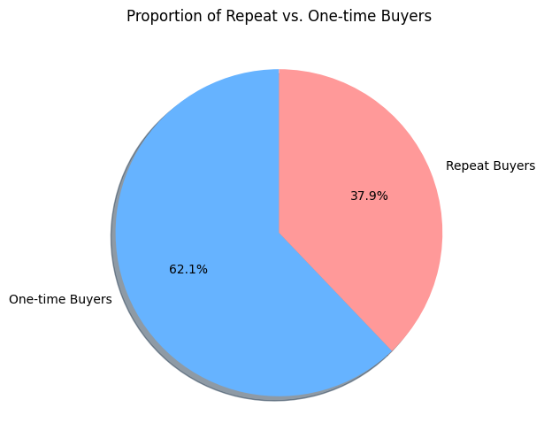
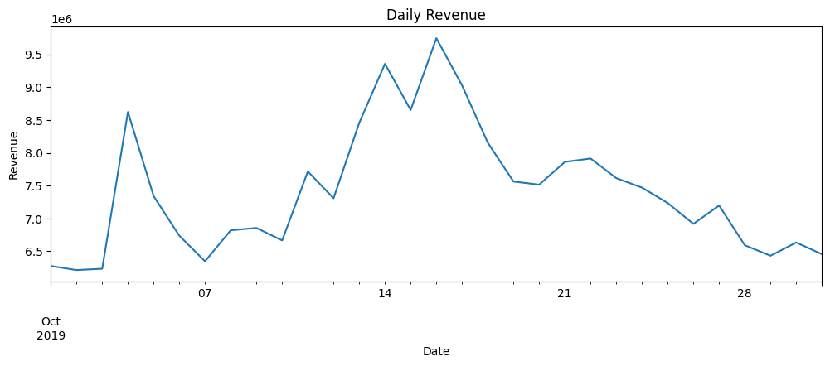
Key Insights
Revenue Volatility:
Daily revenue ranged from ~6M to 9.7M
Peak performance: Mid-October (14th-16th) with revenues exceeding $9.5M
Later trend: Declining in the final week, dropping to ~$6.5M-$6M.
Customer Engagement Metrics:
Average events per user: 14.03 (shows moderate-low engagement)
Repeat purchase rate: 37.86%
Retention: Nearly 2 out of 3 customers are one-time purchasers

Slide 4
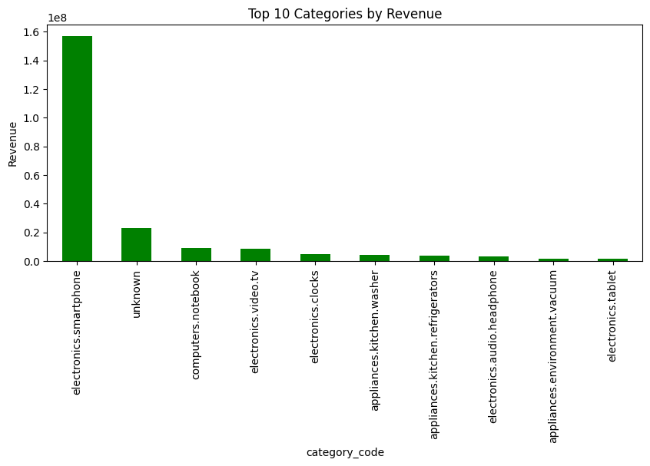
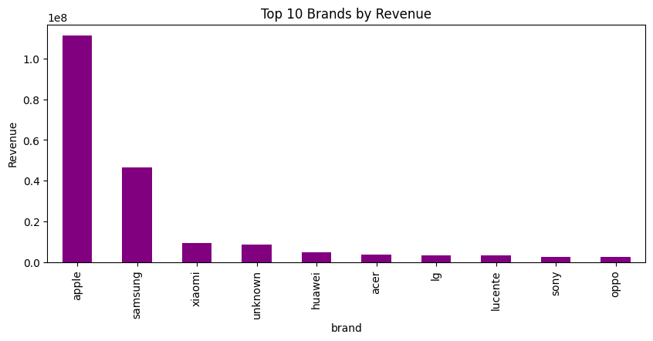
Key Insights
Category-Revenue:
Electronics & Smartphones dominate: $150M+ revenue
Second tier: Unknown category at $24M
Market concentration: Top 2 categories account for approx 70-75% of total revenue.
Brand-Revenue:
Apple leads significantly: $100M+ revenue
Samsung second: ~$50M revenue
Market concentration: Top 2 brands account for approx 70-75% of total revenue.

Slide 5
Business Recommendations
Diversify Revenue Streams:
Expand product categories: Invest in growing underperforming categories (computers, tv, clocks, etc).
Reduce dependency: Reducing dependency on electronics/smartphone category to approx 50-55% of total revenue.
Brand diversification: Developing relationships with emerging brands to reduce sole dependency on Apple/Samsung.
It should be high priority work with a planned timeline of work.
Customer Retention Program:
Target the 62% one-time purchasers: Developing personalized engagement campaigns.
Loyalty program: Creating rewards system to increase repeat purchase rate from 38% to 50%+.
Behavioral targeting: Use the 14+ average events per user to identify high-intent customers for retention efforts.
It should also be high priority work with a planned timeline of work.

